Slide 1
SOFTWARE PACKAGE DESVELOPMENT CLASSMATE

Slide 2
CLASSMATE
PROBLEM STATEMENT:
To build an application that is capable of efficiently satisfying the colloborative needs of students,mentors and administrators in different aspects.
INTRODUCTION:
This is an user friendly portal that provides different features such as enabling the administrators to manage the mentors,facilitating the mentors to continuously monitor and enhance students and it also acts as a useful platform for the students to view the academic details and schedules.

Slide 3
OBJECTIVE
This Project “The ClassMate” attempts to serve as a virtual classroom
which connects the Instructors and Students.
●Its motive lies in serving the purpose of bridging the gap between real-time
and online classes
●This piece of software allows instructors to schedule tests and webinars ,
grade students and mark their attendance etc
● An Instructor will be able to guide the students under him/her and track
their attendance progress and their grades
●In total this website attempts to mimic the Google Classroom

Slide 4
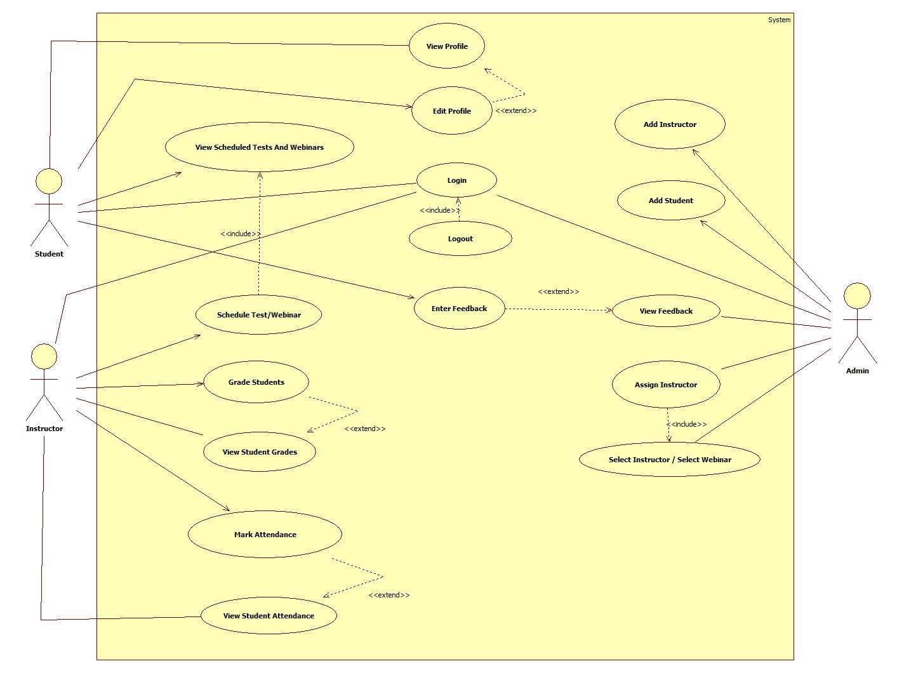
USECASE DIAGRAM

Slide 5
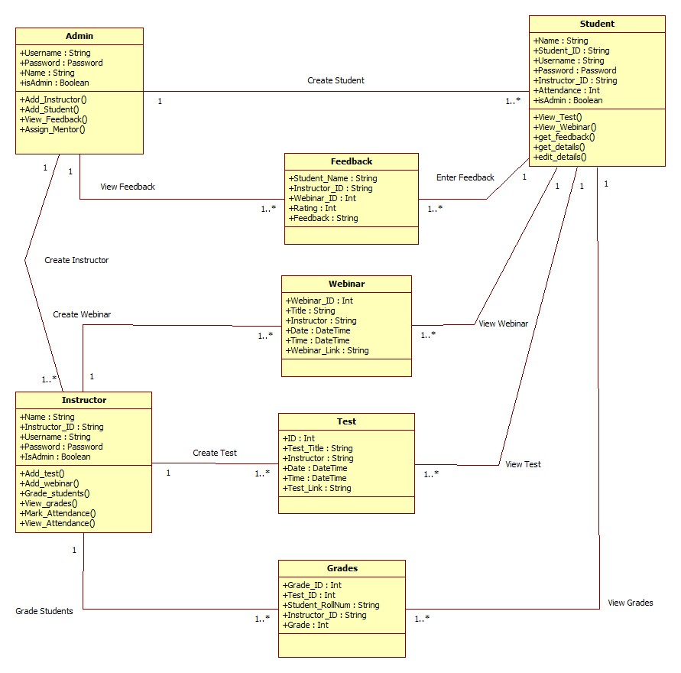
CLASS DIAGRAM

Slide 6
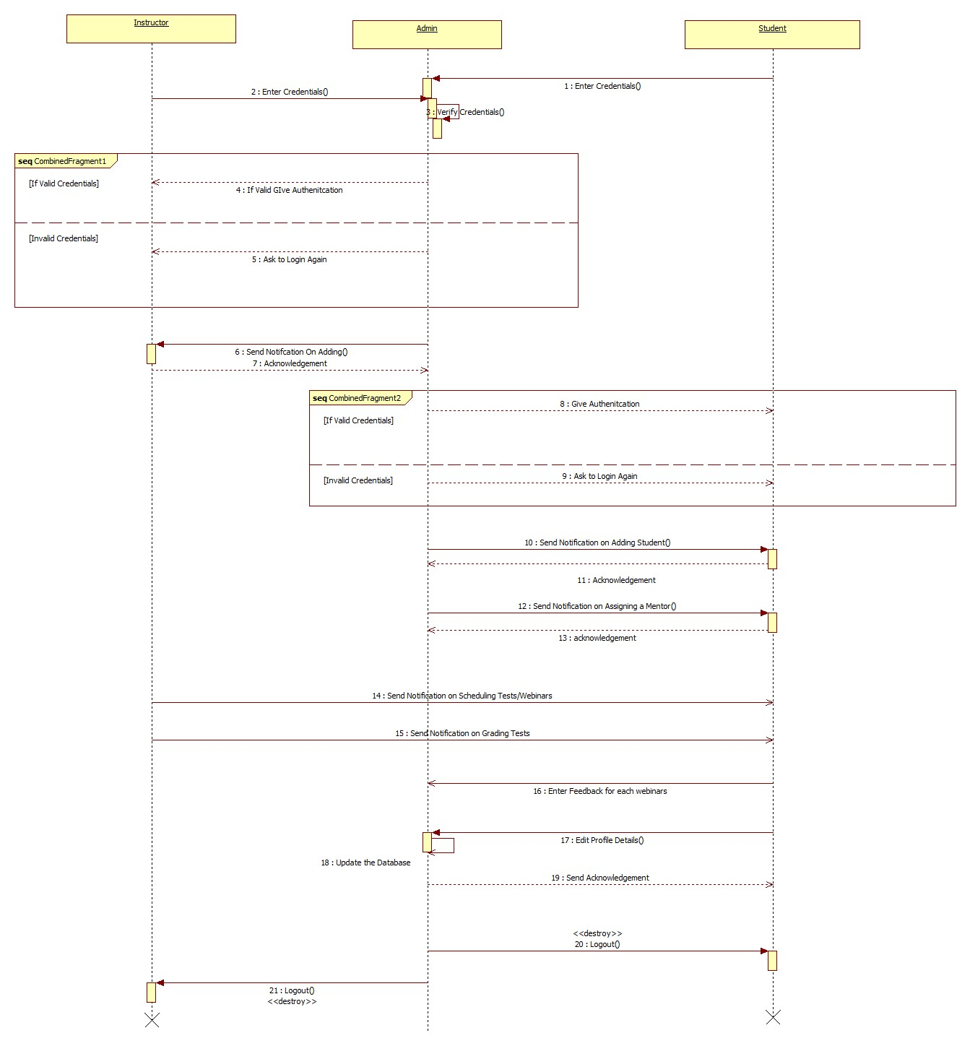
ACTIVITY DIAGRAM

Slide 7
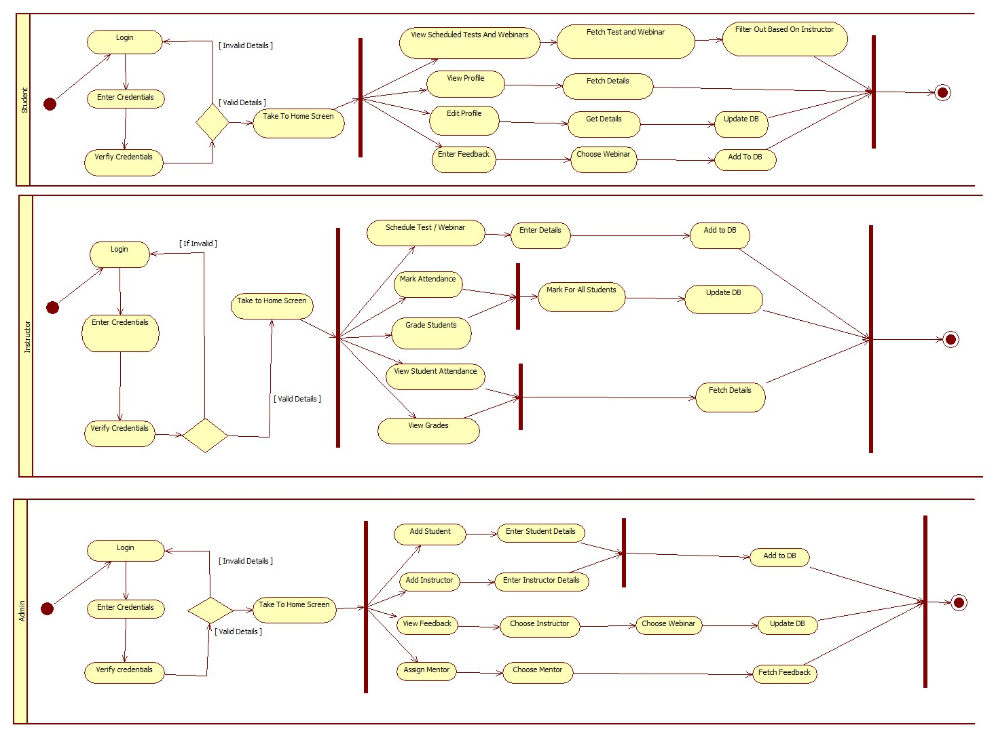
SEQUENCE DIAGRAM

Slide 8
SYSTEM REQUIREMENTS
Admin
Add Student/Instructors
Assign Mentors
View Feedback
Instructor
Schedule Webinar and Tests
Grade Students
Mark Attendance
View Grades / Attendance
Student
View Scheduled tests and webinars
Give Feedback
View Profile

Slide 9
SYSTEM REQUIREMENT
Admin
Add Student/Instructors
The admin can add new students and instructors to the database by entering their details
Assign Mentors
The newly added students need to be assigned a mentor
View Feedback
The feedbacks of the students regarding the faculties can be viewed by the admin to track the instructors’ progress.
Instructor
Schedule Webinar and Tests
The Instructor can schedule tests or webinars by entering the date and time
Grade Students
The instructor can grade the students for those completed tests
Mark Attendance
The instructor can mark the attendance for the students for a specific webinar
View Grades / Attendance
The instructor can track the students’ progress by viewing their attendance and grades

Slide 10
SYSTEM REQUIREMENT
Student
View Scheduled tests and webinars
The students can view their scheduled webinars and tests by their instructors
Give Feedback
The students can give their feedbacks regarding their instructors teachings and also give the ratings.
View Profile
The students will have a personal dashboard where they can track their progress and their attendance and grades

Slide 11

FRONT END-HTML
HyperText Markup Language (HTML) is the set of markup symbols or codes inserted into a file intended for display on the Internet. The markup tells web browsers how to display a web page's words and images.

Slide 12

FRONT END-CSS
CSS stands for Cascading Style Sheets, and it's used to add style to a web page by dictating how a site is displayed on a browser. CSS is unique in that it doesn't create any new elements, like HTML or JavaScript. Instead, it's a language used to style HTML elements.

Slide 13

BACK END-NODE JS
It is used for server-side programming, and primarily deployed for non-blocking, event-driven servers, such as traditional web sites and back-end API services, but was originally designed with real-time, push-based architectures in mind. Every browser has its own version of a JS engine, and node.

Slide 14

BACK END-MONGO DB
MongoDB is a document database used to build highly available and scalable internet applications. With its flexible schema approach, it's popular with development teams using agile methodologies.

